Slide 1
Learning by Computing Distances (2): Wrapping-up LwP, Nearest Neighbors
CS771: Introduction to Machine Learning
Piyush Rai

Slide 2



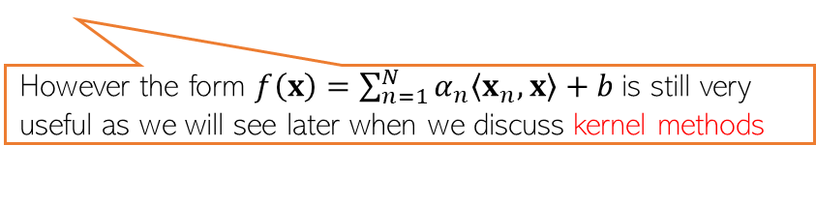
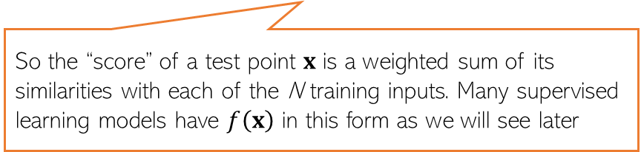

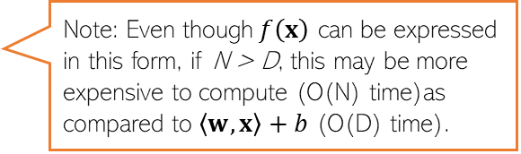
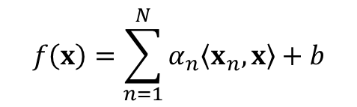

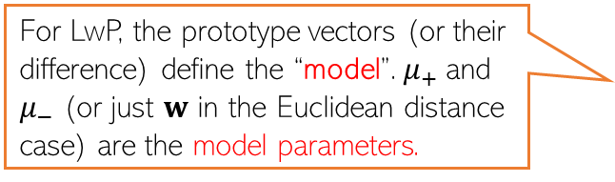



Learning with Prototypes (LwP)
$$μ_{−}= \frac{1}{N_{−}}\sum_{y_{n}=−1}{x_{n}}$$
$$μ_{+}= \frac{1}{N_{+}}\sum_{y_{n}=+1}{x_{n}}$$
$$μ_{−}$$
$$μ_{+}$$
$$w$$
$$w=μ_{+} −μ_{−}$$
Prediction rule for LwP (for binary classification with Euclidean distance)
If Euclidean distance used
$f\left(x\right)= 2\left\langle μ_{+}−μ_{−},x\right\rangle$ + ${\left|\left|μ_{−}\right|\right|}^{2} −{\left|\left|μ_{+}\right|\right|}^{2}= \left\langle w,x\right\rangle +b$
For LwP, the prototype vectors (or their difference) define the “model”. $μ_{+}$and $μ_{−}$ (or just $w$ in the Euclidean distance case) are the model parameters.
Decision boundary
(perpendicular bisector of line joining the class prototype vectors)
($f\left(x\right)$> 0 then predict +1 otherwise -1)
Exercise: Show that for the bin. classfn case
$$f\left(x\right)=\sum_{n=1}^{N}{α_{n}\left\langle x_{n},x\right\rangle +b}$$
Note: Even though$f\left(x\right)$ can be expressed in this form, if N > D, this may be more expensive to compute (O(N) time)as compared to $\left\langle w,x\right\rangle +b$ (O(D) time).
Can throw away training data after computing the prototypes and just need to keep the model parameters for the test time in such “parametric” models
So the “score” of a test point $x$ is a weighted sum of its similarities with each of the N training inputs. Many supervised learning models have $f\left(x\right)$ in this form as we will see later
However the form $f\left(x\right)=\sum_{n=1}^{N}{α_{n}\left\langle x_{n},x\right\rangle +b}$is still very useful as we will see later when we discuss kernel methods

Slide 3
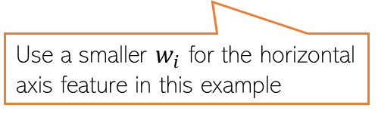
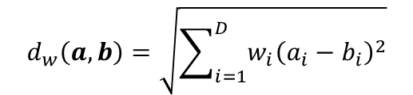






Improving LwP when classes are complex-shaped
Using weighted Euclidean or Mahalanobis distance can sometimes help
Note: Mahalanobis distance also has the effect of rotating the axes which helps
$$μ_{+}$$
$$d_{w}\left(a,b\right)=\sqrt{\sum_{i=1}^{D}{{w_{i}\left(a_{i}−b_{i}\right)}^{2}}}$$
$$μ_{−}$$
Use a smaller $w_{i}$ for the horizontal axis feature in this example
A good W will help bring points from same class closer and move different classes apart
W will be a 2x2 symmetric matrix in this case (chosen by us or learned)
$$μ_{−}$$
$$d_{w}\left(a,b\right)=\sqrt{{\left(a−b\right)}^{⊤}W\left(a−b\right)}$$
$$μ_{+}$$
$$μ_{+}$$
$$μ_{−}$$

Slide 4
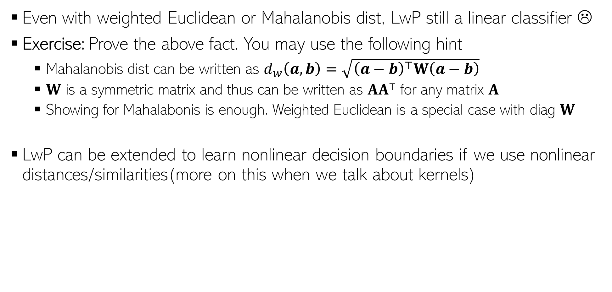
Improving LwP when classes are complex-shaped
Even with weighted Euclidean or Mahalanobis dist, LwP still a linear classifier ☹
Exercise: Prove the above fact. You may use the following hint
Mahalanobis dist can be written as $d_{w}\left(a,b\right)=\sqrt{{\left(a−b\right)}^{⊤}W\left(a−b\right)}$
$W$ is a symmetric matrix and thus can be written as $AA⊤$ for any matrix $A$
Showing for Mahalabonis is enough. Weighted Euclidean is a special case with diag $W$
LwP can be extended to learn nonlinear decision boundaries if we use nonlinear distances/similarities(more on this when we talk about kernels)
Note: Modeling each class by not just a mean by a probability distribution can also help in learning nonlinear decision boundaries. More on this when we discuss probabilistic models for classification

Slide 5
LwP as a subroutine in other ML models
For data-clustering (unsupervised learning), K-means clustering is a popular algo
K-means also computes means/centres/prototypes of groups of unlabeled points
Harder than LwP since labels are unknown. But we can do the following
Guess the label of each point, compute means using guess labels
Refine labels using these means (assign each point to the current closest mean)
Repeat until means don’t change anymore
Many other models also use LwP as a subroutine
Will see K-means in detail later

Slide 6
Supervised Learning using Nearest Neighbors

Slide 7

Nearest Neighbors
Another supervised learning technique based on computing distances
Very simple idea. Simply do the following at test time
Compute distance of of the test point from all the training points
Sort the distances to find the “nearest” input(s) in training data
Predict the label using majority or avg label of these inputs
Can use Euclidean or other dist (e.g., Mahalanobis). Choice imp just like LwP
Unlike LwP which does prototype based comparison, nearest neighbors method looks at the labels of individual training inputs to make prediction
Applicable to both classifn as well as regression (LwP only works for classifn)
Wait. Did you say distance from ALL the training points? That’s gonna be sooooo expensive! ☹
Yes, but let’s not worry about that at the moment. There are ways to speed up this step

Slide 8
Nearest Neighbors for Classification

Slide 9

Nearest Neighbor (or “One” Nearest Neighbor)
Decision boundary
Interesting. Even with Euclidean distances, it can learn nonlinear decision boundaries?
Indeed. And that’s possible since it is a “local” method (looks at a local neighborhood of the test point to make prediction)
Nearest neighbour approach induces a Voronoi tessellation/partition of the input space (all test points falling in a cell will get the label of the training input in that cell)
Test point
Test point

Slide 10



K Nearest Neighbors (KNN)
In many cases, it helps to look at not one but $K$ > 1 nearest neighbors
Essentially, taking more votes helps!
Also leads to smoother decision boundaries (less chances of overfitting on training data)
$K$ = 1
Test input
$K$ = 3
How to pick the “right” K value?
K is this model’s “hyperparameter”. One way to choose it is using “cross-validation” (will see shortly)
Also, K should ideally be an odd number to avoid ties

Slide 11
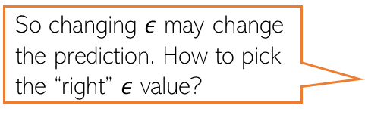
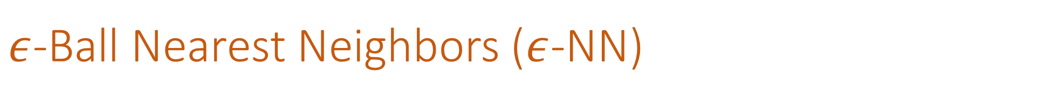

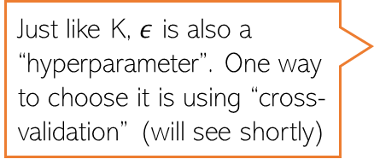
$ε$-Ball Nearest Neighbors ($ε$-NN)
Rather than looking at a fixed number $K$ of neighbors, can look inside a ball of a given radius $ε$, around the test input
So changing $ε$ may change the prediction. How to pick the “right” $ε$ value?
Test input
Just like K, $ε$ is also a “hyperparameter”. One way to choose it is using “cross-validation” (will see shortly)

Slide 12







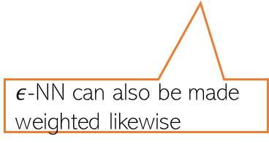
Distance-weighted KNN and $ε$-NN
The standard KNN and 𝜖-NN treat all nearest neighbors equally (all vote equally)
An improvement: When voting, give more importance to closer training inputs
$K$ = 3
Test input
$$\frac{1}{3}$$
+
$$\frac{1}{3}$$
+
$$\frac{1}{3}$$
=
In weighted approach, a single red training input is being given 3 times more importance than the other two green inputs since it is sort of “three times” closer to the test input than the other two green inputs
Unweighted KNN prediction:
$$\frac{3}{5}$$
+
$$\frac{1}{5}$$
+
$$\frac{1}{5}$$
=
Weighted KNN prediction:
$ε$-NN can also be made weighted likewise

Slide 13
KNN/$ε$-NN for Other Supervised Learning Problems
Can apply KNN/𝜖-NN for other supervised learning problems as well, such as
Multi-class classification
Regression
Tagging/multi-label learning
For multi-class, simply used the same majority rule like in binary classfn case
Just a simple difference that now we have more than 2 classes
For regression, simply compute the average of the outputs of nearest neighbors
For multi-label learning, each output is a binary vector (presence/absence of tag)
Just compute the average of the binary vectors
Result won’t be a binary vector but we can report the best tags based on magnitudes
We can also try the weighted versions for such problems, just like we did in the case of binary classification

Slide 14

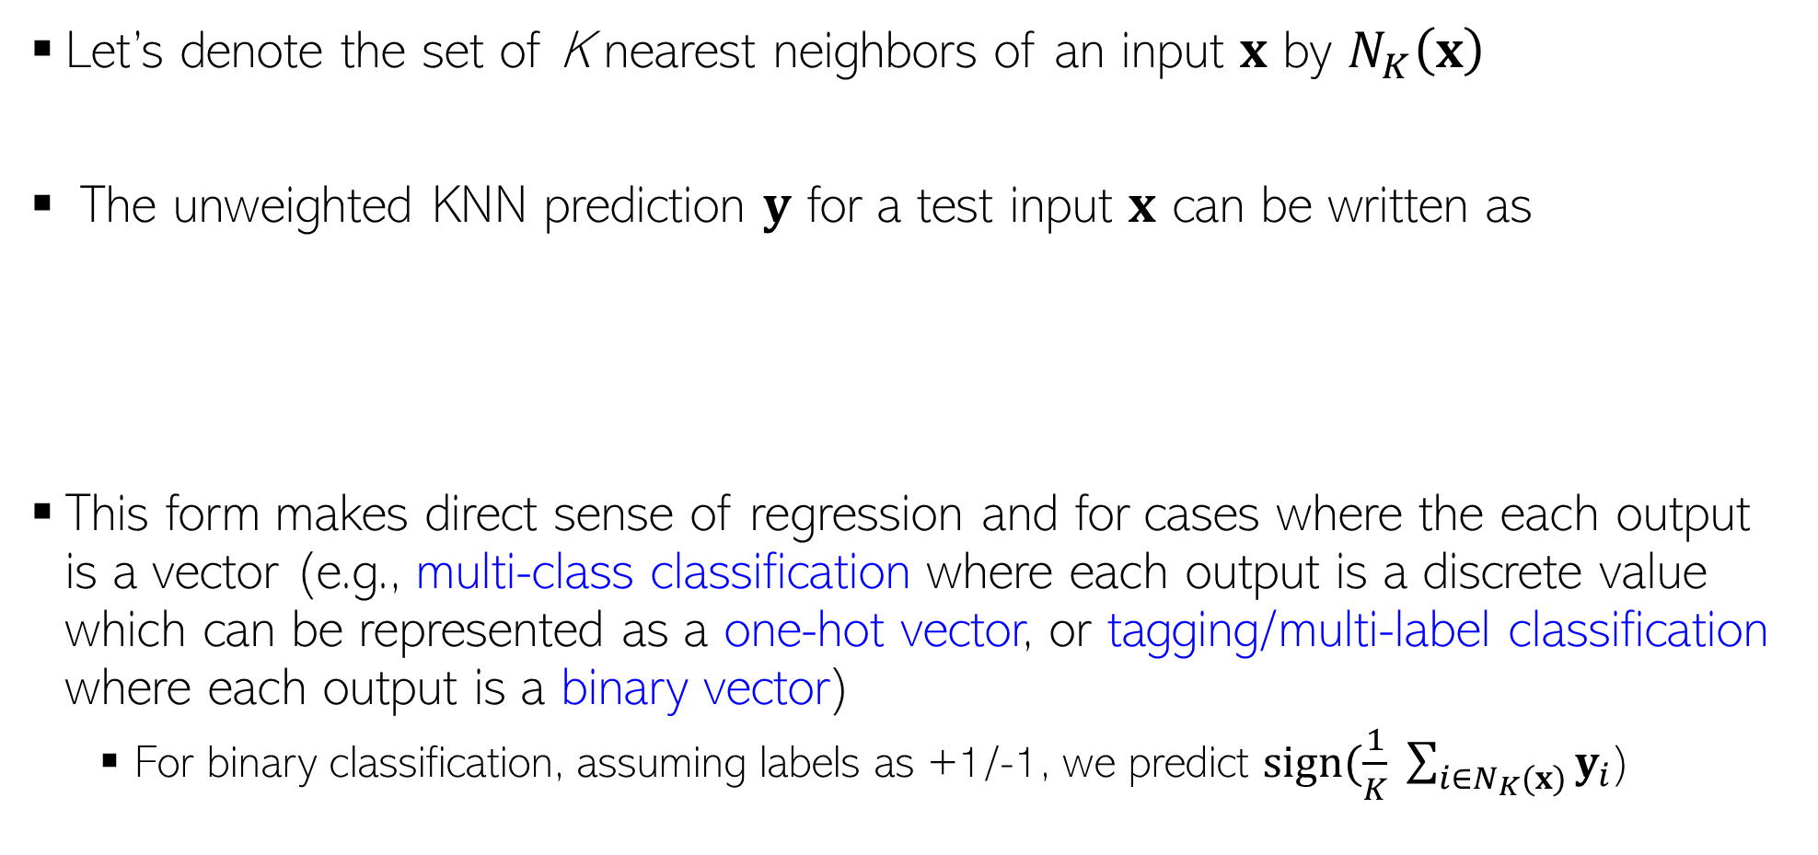
KNN Prediction Rule: The Mathematical Form
Let’s denote the set of K nearest neighbors of an input $x$ by $N_{K}\left(x\right)$
The unweighted KNN prediction $y$ for a test input $x$ can be written as
This form makes direct sense of regression and for cases where the each output is a vector (e.g., multi-class classification where each output is a discrete value which can be represented as a one-hot vector, or tagging/multi-label classification where each output is a binary vector)
For binary classification, assuming labels as +1/-1, we predict $sign(\frac{1}{K} \sum_{i∈N_{K}(x)}{y_{i}}$)
Assuming discrete labels with 5 possible values, the one-hot representation will be a all zeros vector of size 5, except a single 1 denoting the value of the discrete label, e.g., if label = 3 then one-hot vector = [0,0,1,0,0]
$$y= \frac{1}{K} \sum_{i∈N_{K}(x)}{y_{i}}$$

Slide 15
Nearest Neighbors: Some Comments
An old, classic but still very widely used algorithm
Can sometimes give deep neural networks a run for their money ☺
Can work very well in practical with the right distance function
Comes with very nice theoretical guarantees
Also called a memory-based or instance-based or non-parametric method
No “model” is learned here (unlike LwP). Prediction step uses all the training data
Requires lots of storage (need to keep all the training data at test time)
Prediction step can be slow at test time
For each test point, need to compute its distance from all the training points
Clever data-structures or data-summarization techniques can provide speed-ups

Slide 16
Next Lecture
Hyperparameter/model selection via cross-validation
Learning with Decision Trees

